Slide 1
Single Image Super-resolution from Transformed Self-Exemplars
Advanced Image Processing course project
Mikko Impiö
Based on:
Huang, J. B., Singh, A., & Ahuja, N. (2015). Single image super-resolution from transformed self-exemplars. CVPR2015

Slide 2
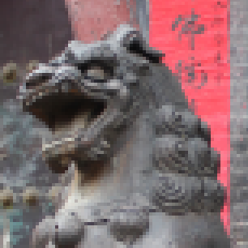

Introduction
Super-resolution attempts to obtain a high-resolution (HR) image from a low-resolution image (LR)
Generally an ill-posed problem: a LR image can represent multiple HR images
Single image SR can be divided to interpolation-based methods, reconstruction-based methods and learning-based methods (Yang et. al. 2019)
Low-resolution (LR) image
High-resolution (HR) image

Slide 3
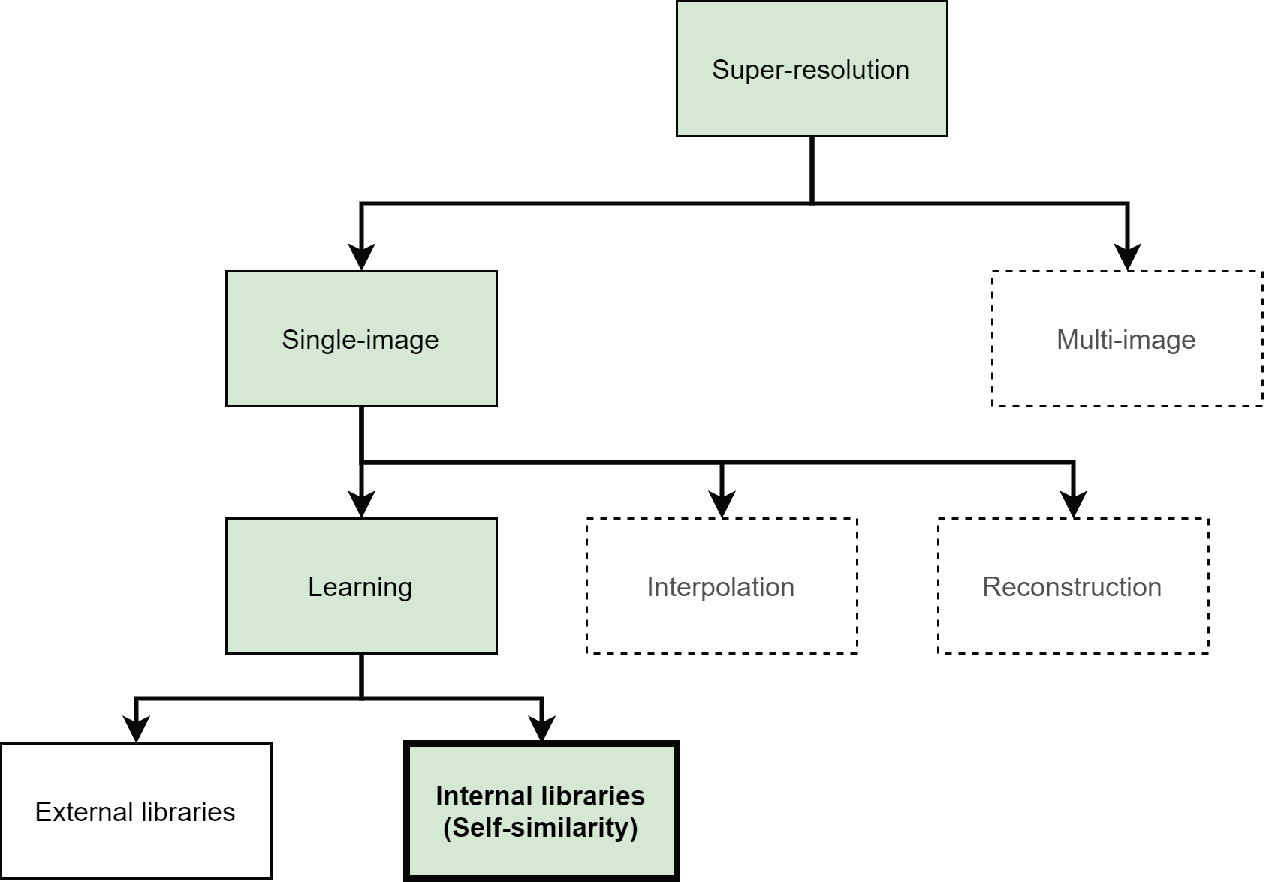
Introduction

Slide 4
Literature review
Overviews:
Yang et al. (2019): Deep learning overview
Yang and Huang (2017): Historical overview and overview of most methods
Nasrollahi and Moeslund (2014): Comprehensive study of all methods
Important papers:
Duchon (1979): Lanczos filtering, that is commonly used in interpolation
Freeman et al. (2002): First papers on example-based SR
Yang (2010): Sparse representation based SR, dictionary learning
Dong et al. (2015): First really good CNN based SR
Other internal library methods related to the paper:
Ebrahimi et al.(2007): Self-example inspiration from fractal-based methods
Glasner et al. (2009): First examples on patch redundancy
Sing et al. (2015): Sub-band self-similarity
Yang et al. (2013) Local self-similar patches
State-of the art methods:
Kim et al. (2016): DRCN, based on recursive convolutional networks
Ledig et al. (2017): SRResNet / SRGAN, based on a GANs
Zhang et al. (2018) RDN, based on residual networks
Blue: presented by others on this course
Green: used as a reference in this presentation

Slide 5
Problems addressed:
Research question
Contributions by Huang et al.
External library based methods need external images
Internal library based methods usually use just affine transformations when searching patches, like in Glasner et al. (2009) or Yang et al. (2013)
Proposed method increases the size of the internal dictionary by using more flexible transformations
Proposed decomposition of the patch transformation into two parts:
Perspective distortion
Affine transformation

Slide 6
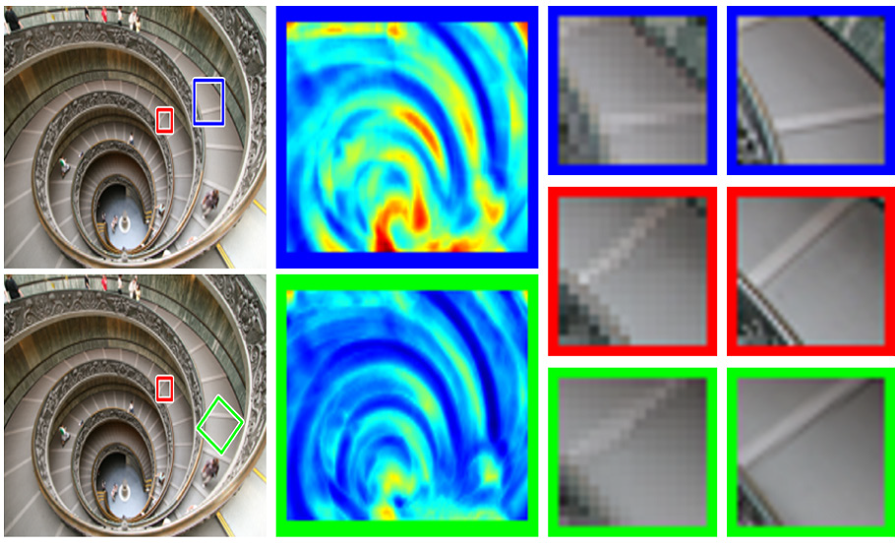
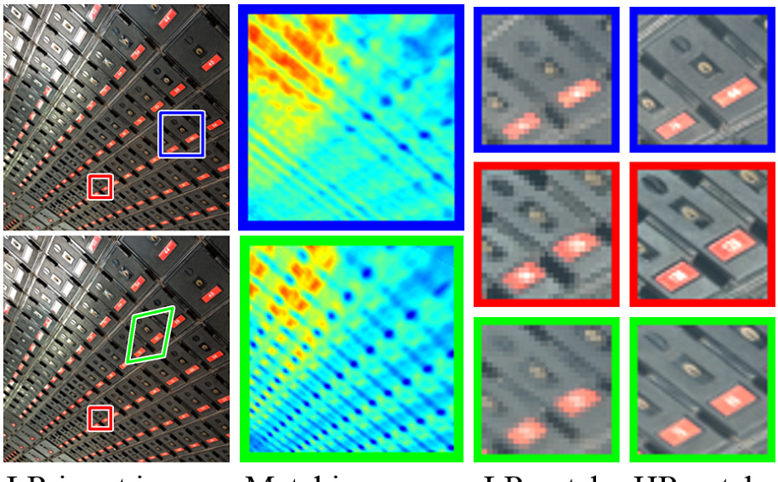
Why use complex transformations?
Only translation and scaling
Reference
Compare!
Affine transformation
LR input image
Matching error
HR and LR comparison
Only translation
vs.
Affine transformation
+
planar perspective transformation
Only translation and scaling
Reference
Compare!
Planar perspective transformation
Huang et al. (2015)

Slide 7
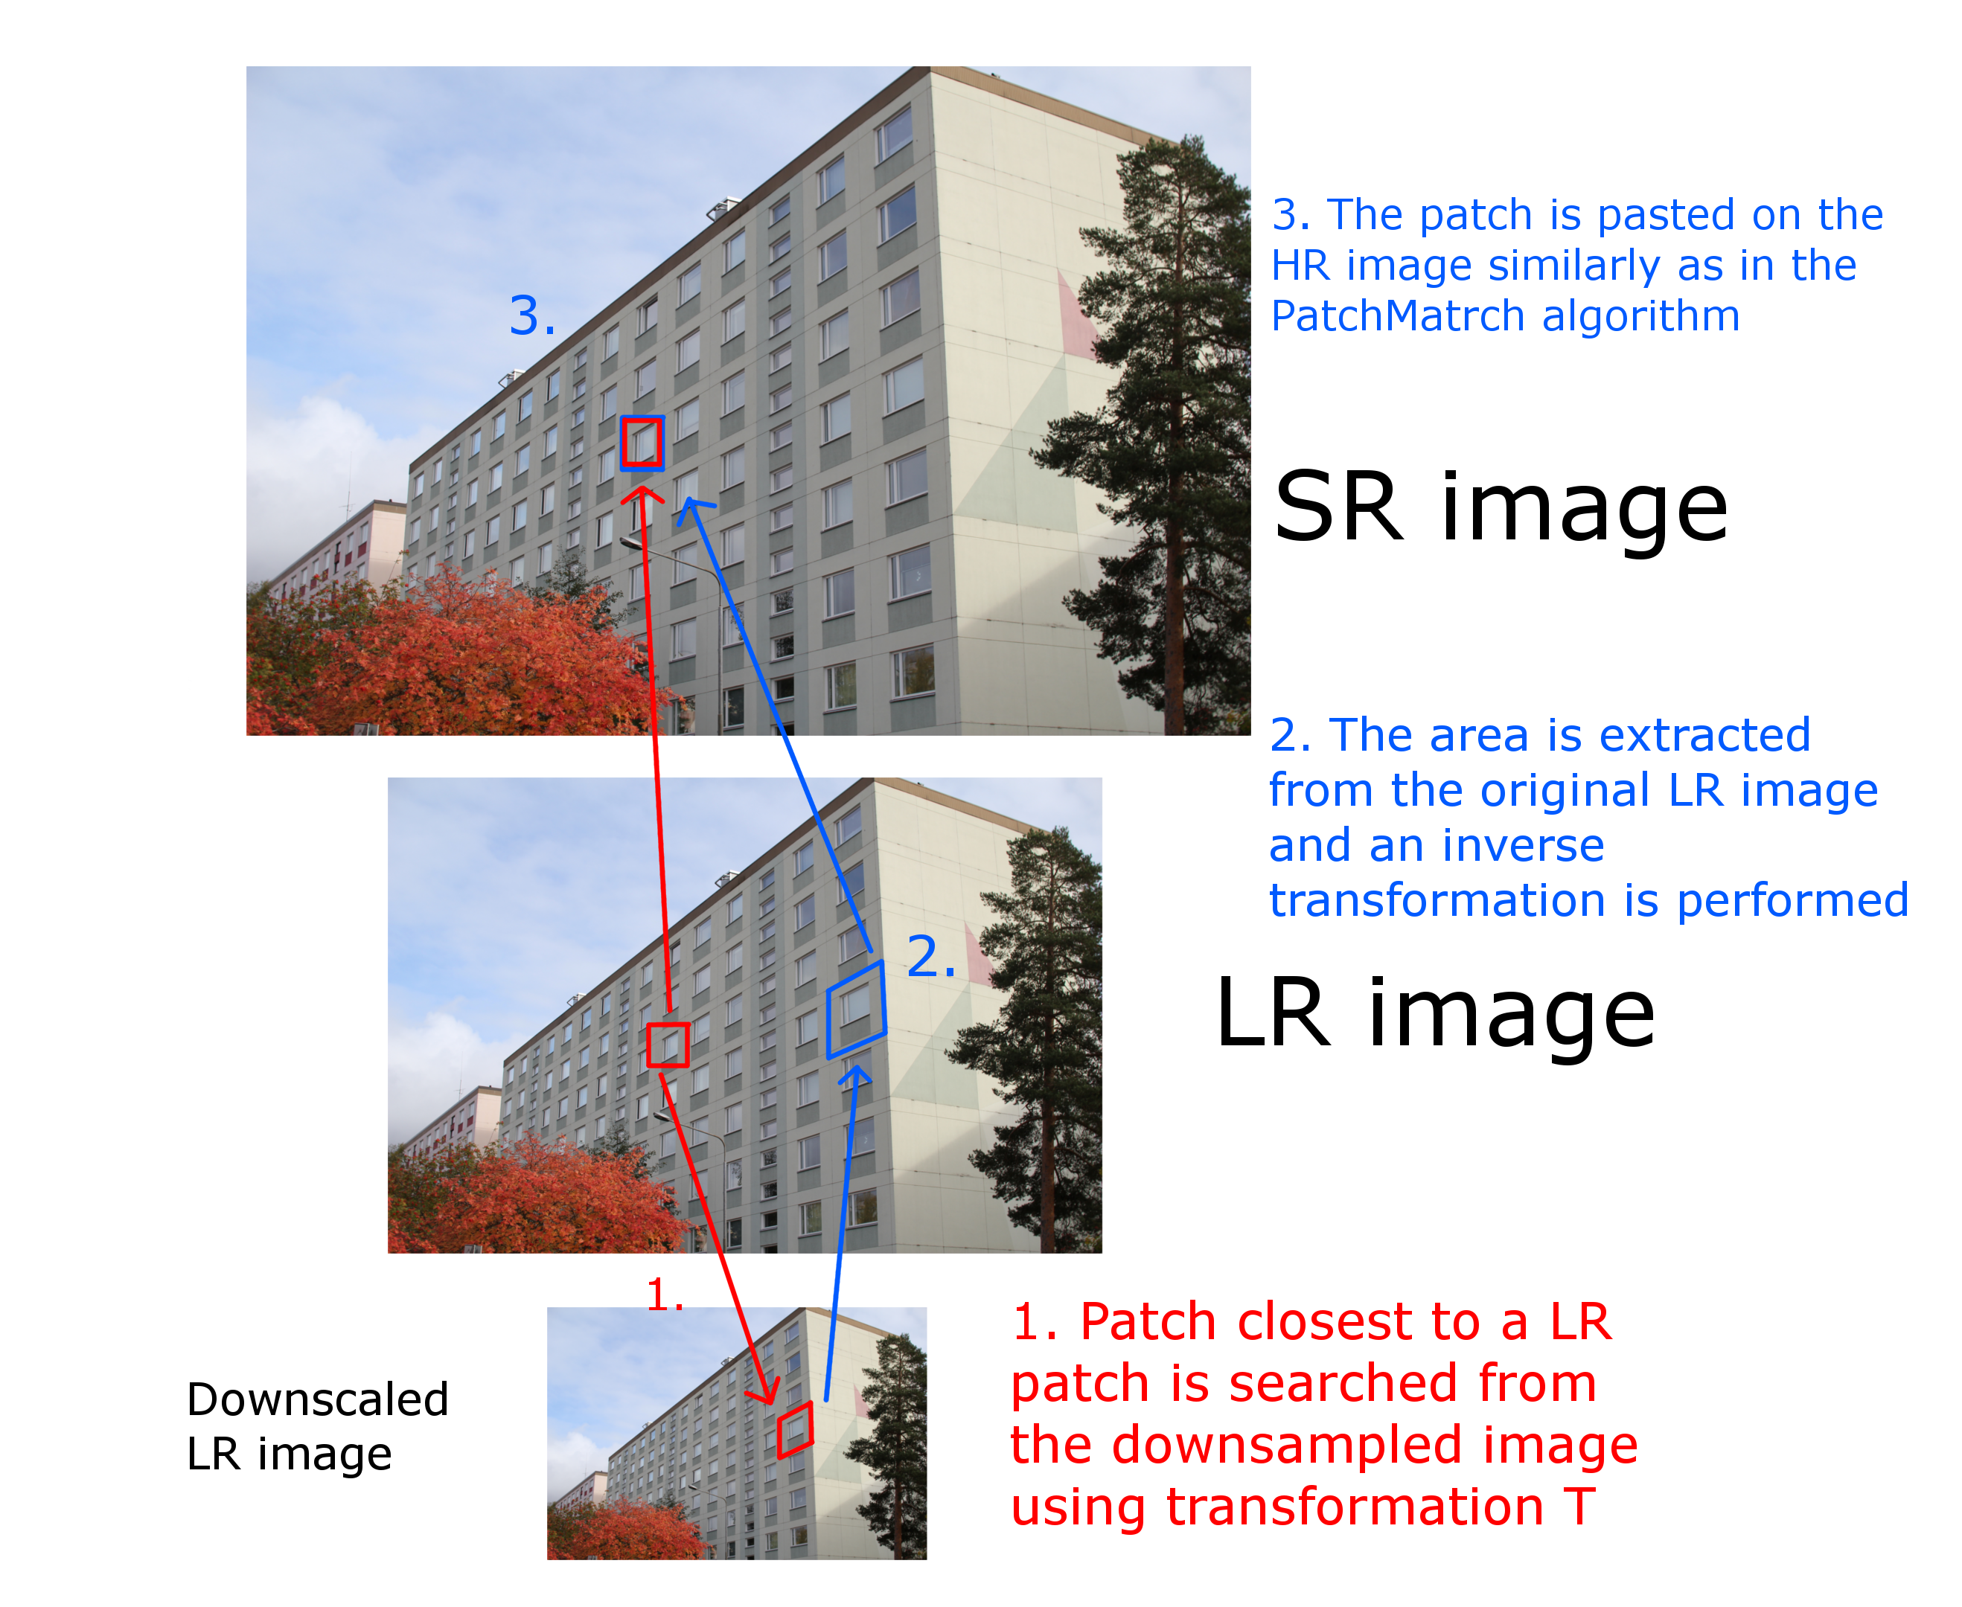
Overview
Input LR image is first low-pass filtered and downscaled
For each target patch in the original, a source patch is selected from the downscaled image
A transformation matrix T is estimated between the source and target patches.
The most similar transformed patch is extracted from the original image and pasted on the SR image
This is repeated and finally the image is refined by backprojection

Slide 8
Overview
Two important methods:
PatchMatch algorithm with modified objective function
Plane estimation to reduce search space dimensionality

Slide 9
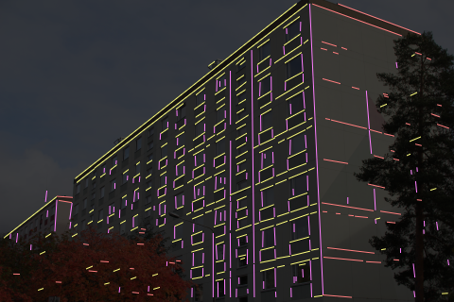
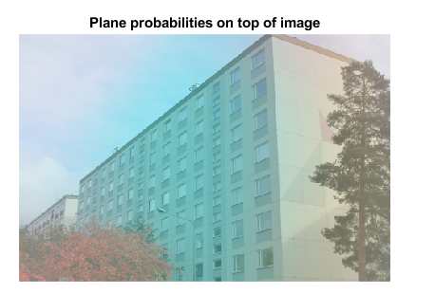
Plane estimation
Vanishing points
Planes in cyan, yellow and magenta

Slide 10
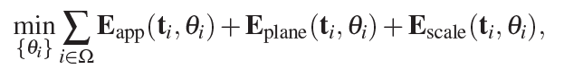

Nearest-neighbor-field estimation
NNF is found using the PatchMatch algorithm and a modified cost function
Cost function consists of three costs:
Appearance cost: how similar the patches are?
Plane cost: are the patches on the same plane?
Scale cost: are the patches of similar size?
Search is performed over the parameter space
$$θ_{i}=\left(s_{i}^{x}, s_{i}^{y},s_{i}^{s},s_{i}^{α}, s_{i}^{β},m_{i}\right)$$
Where s is the source patch and its affine transformation and translation parameters and m is the plane the patch is on

Slide 11
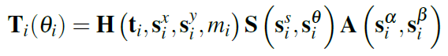
Transformation matrix
Similarity (scaling, rotation)
Perspective deformation
Shearing (together with S produces affine transformation)

Slide 12
Implementation
Authors have provided MATLAB code for the implementation (https://github.com/jbhuang0604/SelfExSR)
This was throughly inspected and partly modified to a simpler version with visualizations

Slide 13
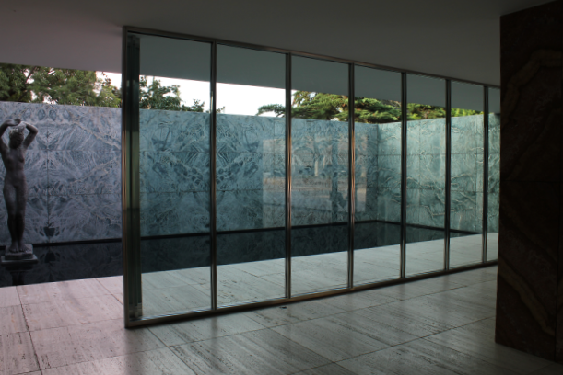
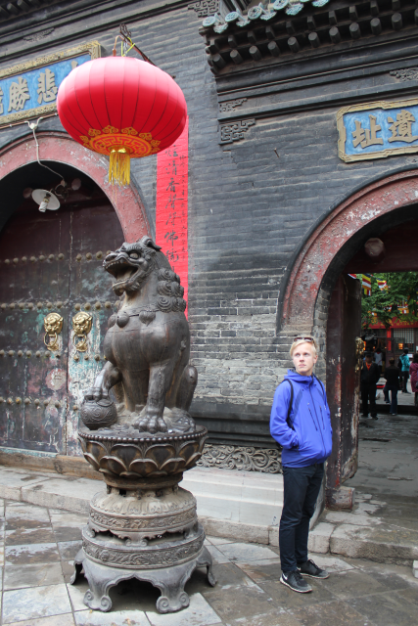
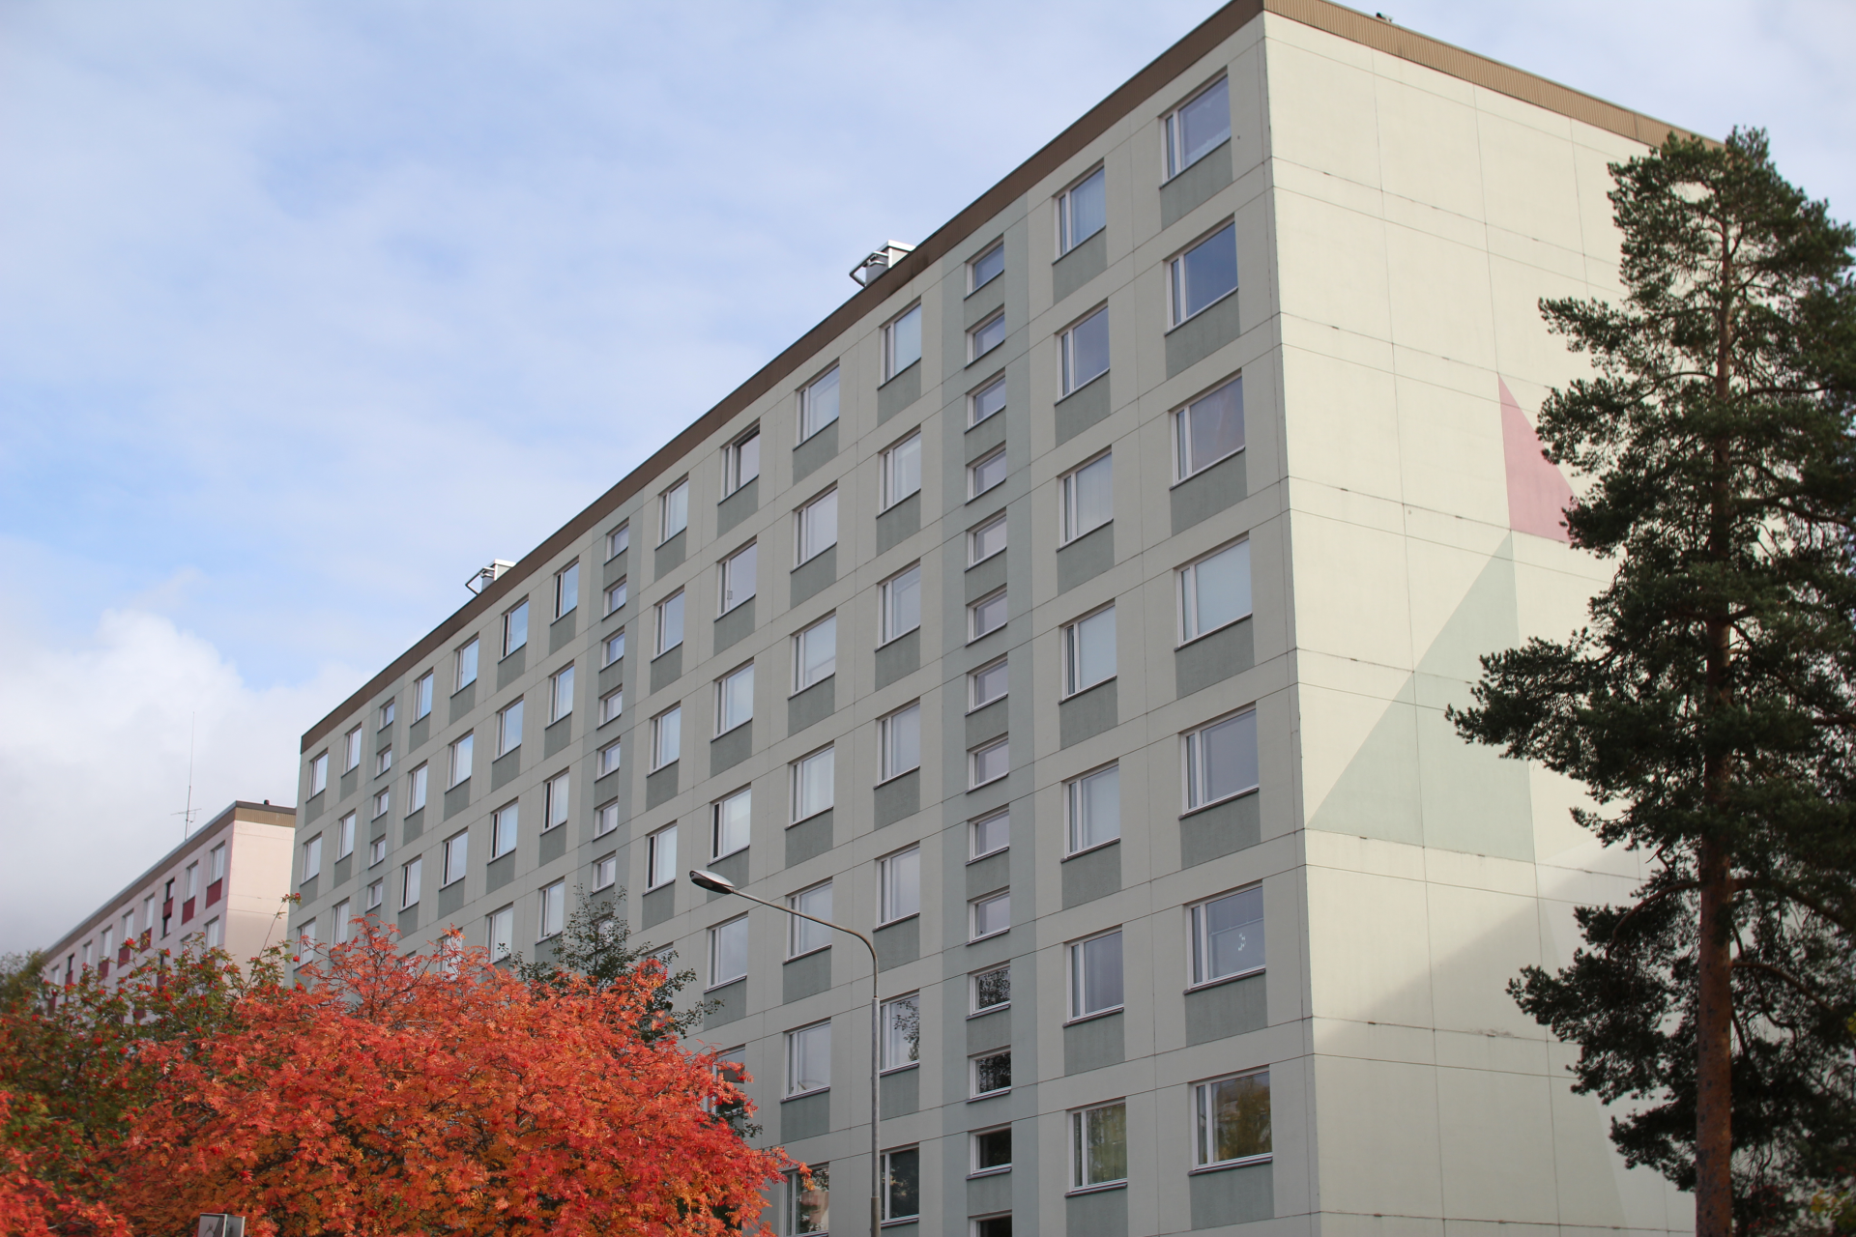
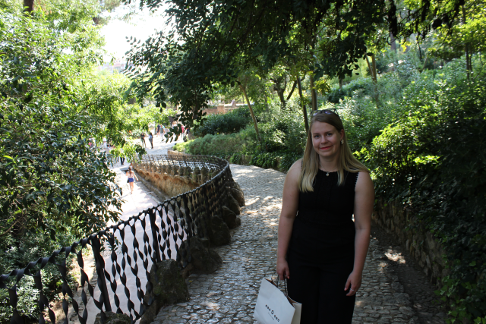
Results
Image quality and some PSNR assessments were performed on a custom dataset consisting of both urban and natural scenes.
Dataset images were chosen to include both challenging images as well as images with large amounts of self-similarity
Comparisons were made to SRGAN and bilinear interpolation methods

Slide 14
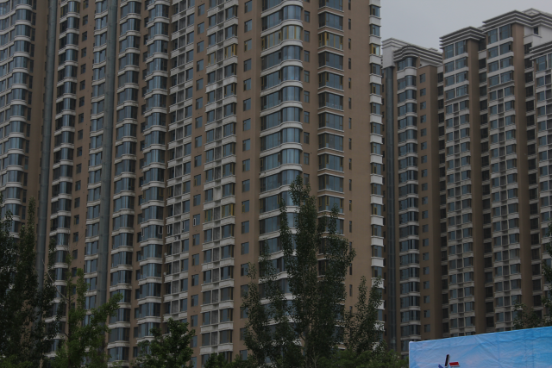
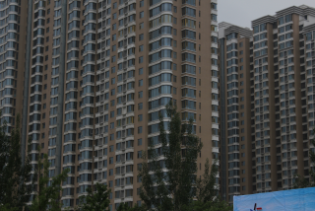


VGA: 2x SR
Origina)l
Bilinear
SelfExSR
Bilinear +
Sharpening

Slide 15
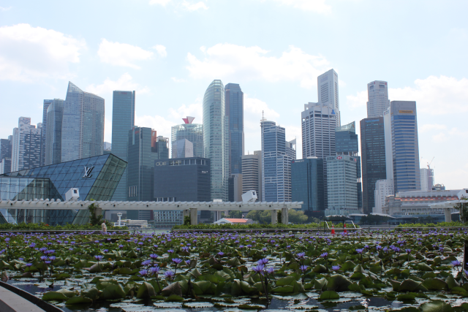
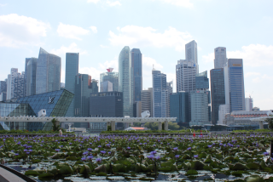


VGA: 2x SR
Original
Bilinear
SelfExSR
Bilinear +
Sharpening

Slide 16
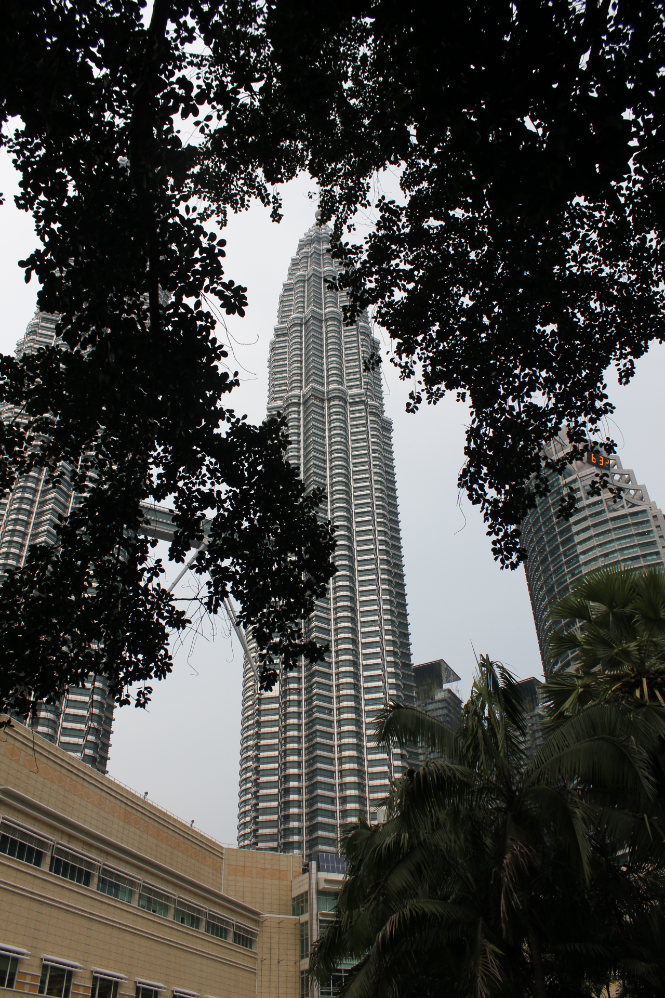
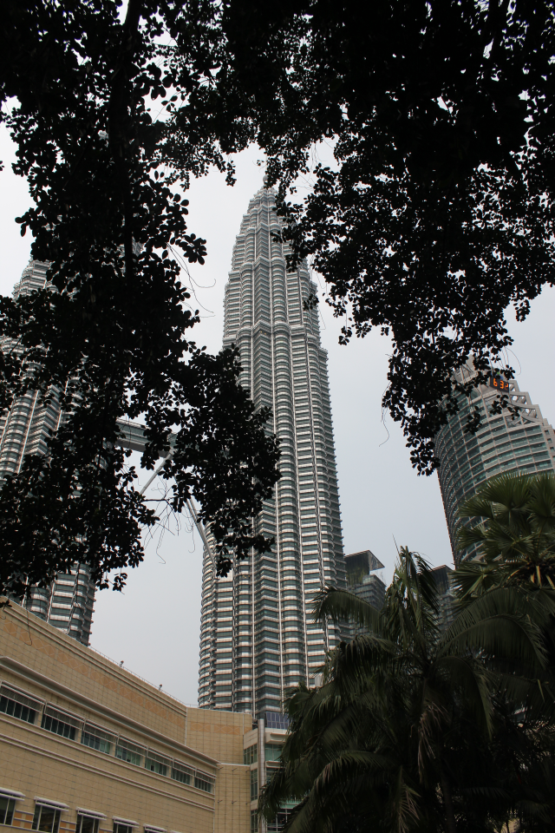


HD: 2x SR
Original
Bilinear
SelfExSR
Bilinear +
Sharpening

Slide 17
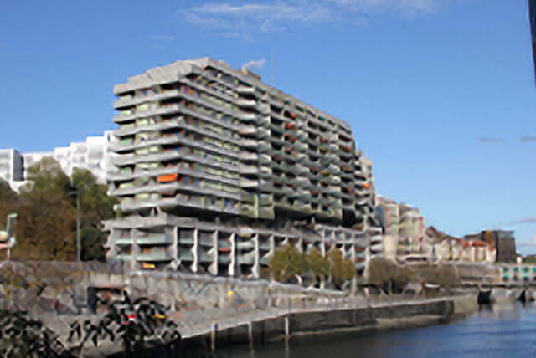



VGA: 4x SR
Bilinear +
Sharpening
Bilinear
SelfExSR
Original

Slide 18



VGA: 4x SR
Original
Bilinear
SelfExSR
Bilinear +
Sharpening

Slide 19
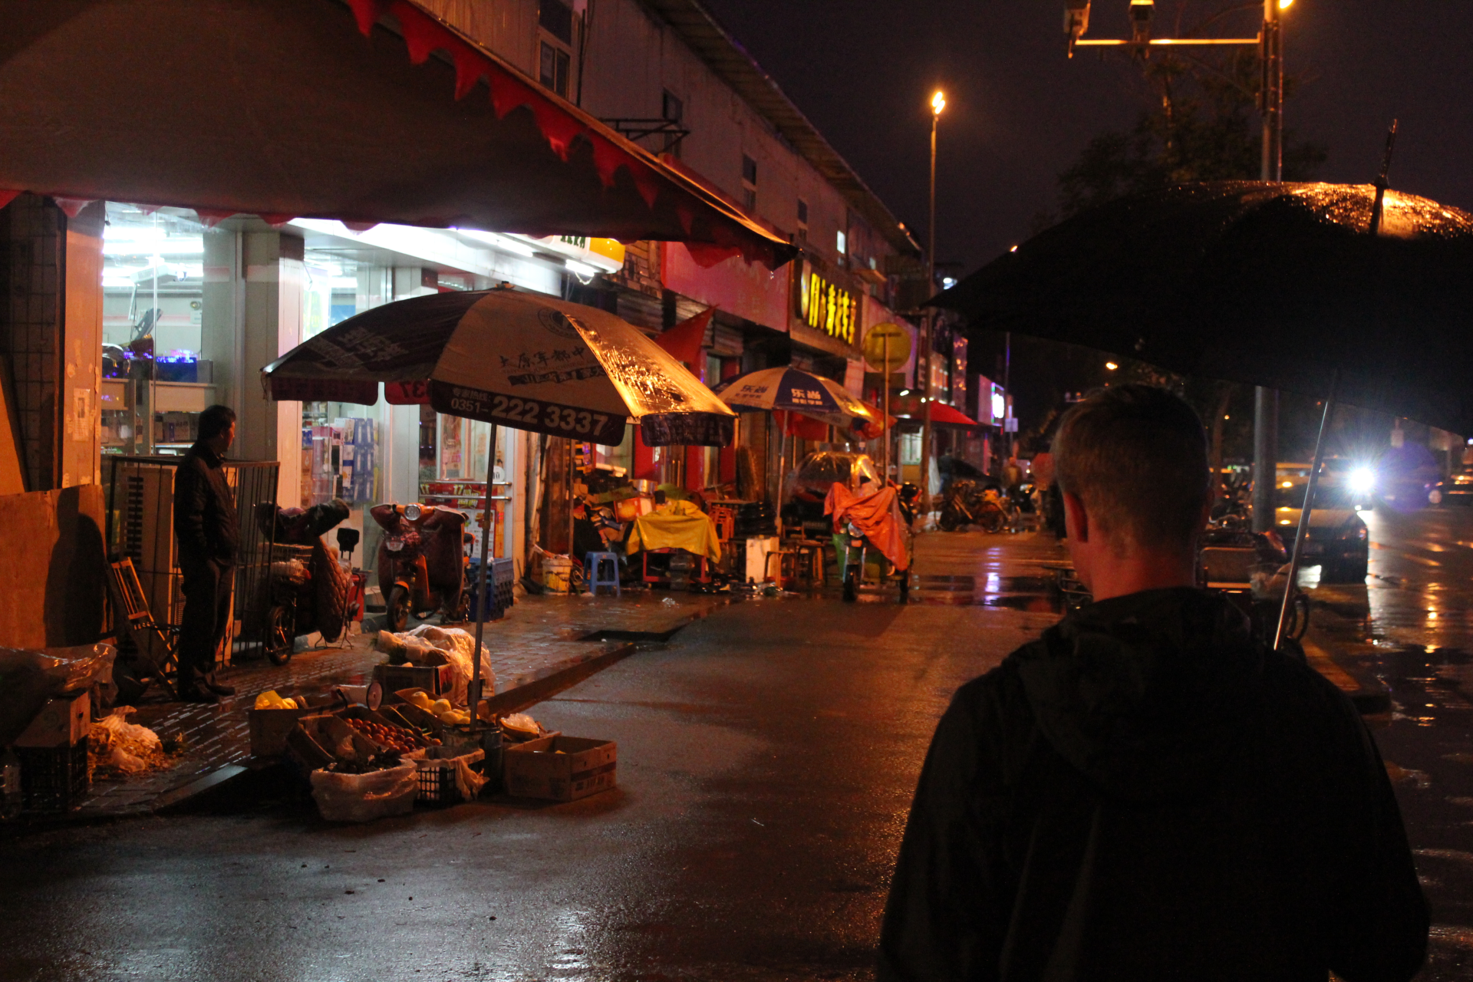



HD: 4x SR
Original
(PSNR)
Bilinear
SelfExSR
(31.40)
Bilinear +
Sharpening
(29.31)

Slide 20

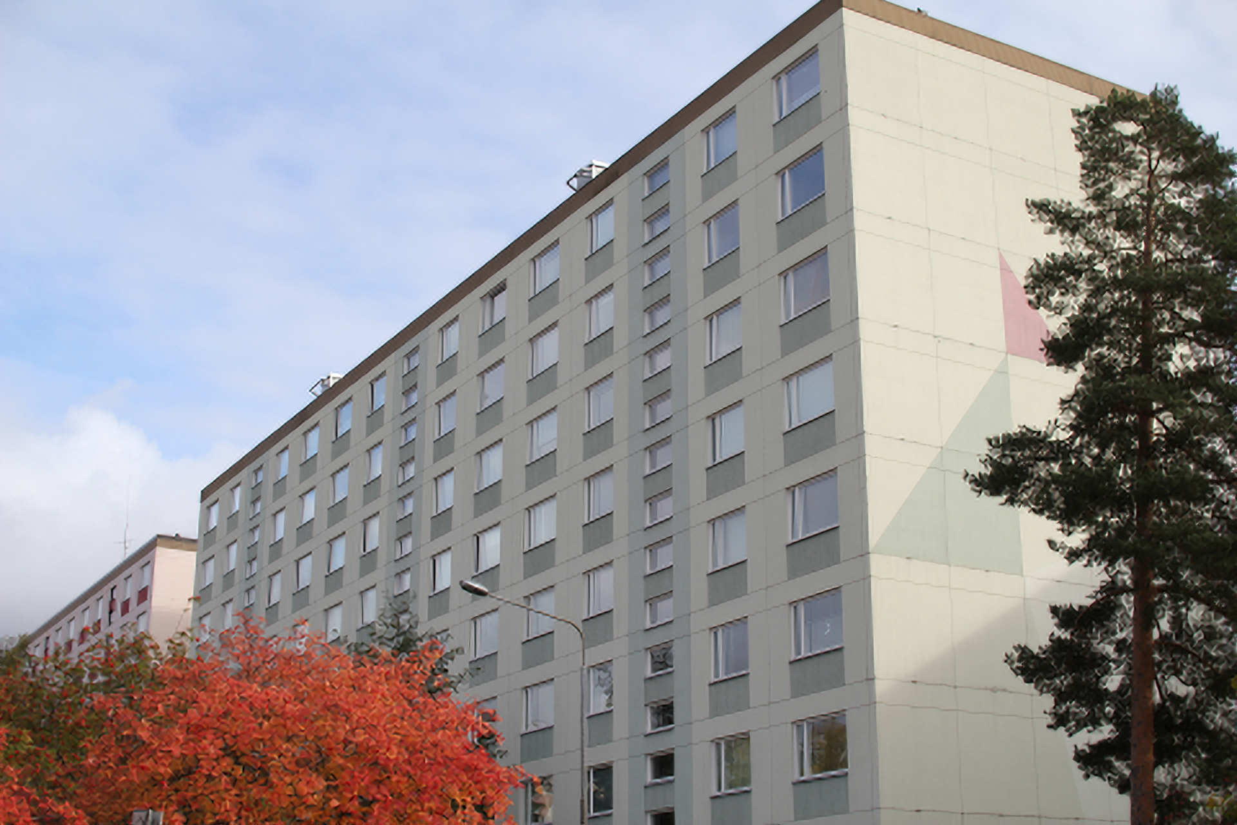

HD: 4x SR
Origina
(PSNR)l
Bilinear
SelfExSR
(28.57)
Bilinear +
Sharpening
(26.09)

Slide 21
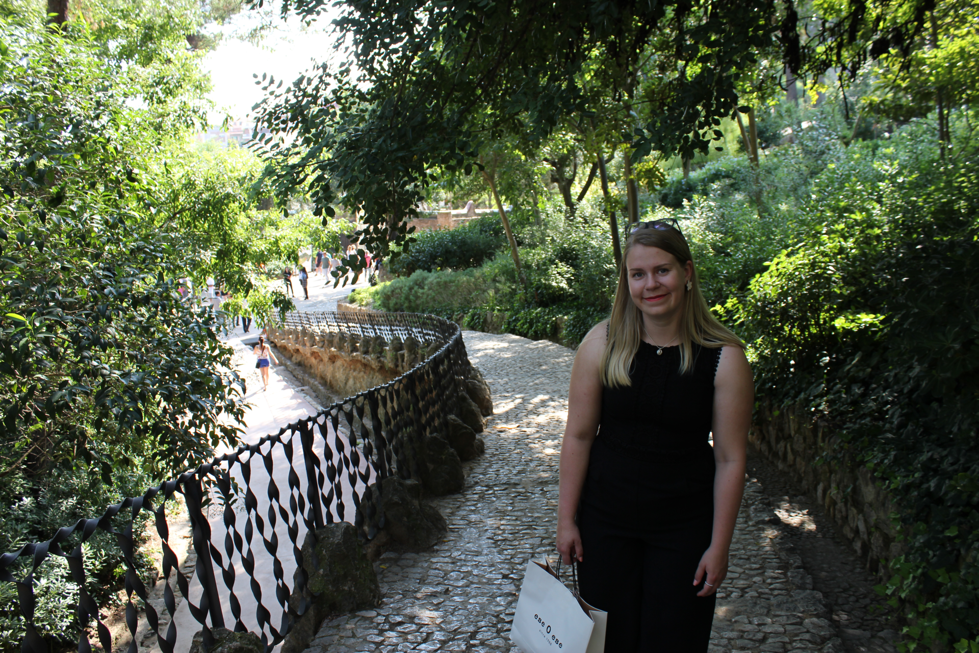


HD: 8x SR
Original
Bilinear
SelfExSR

Slide 22



HD: 8x SR
Original
Bilinear
SelfExSR

Slide 23
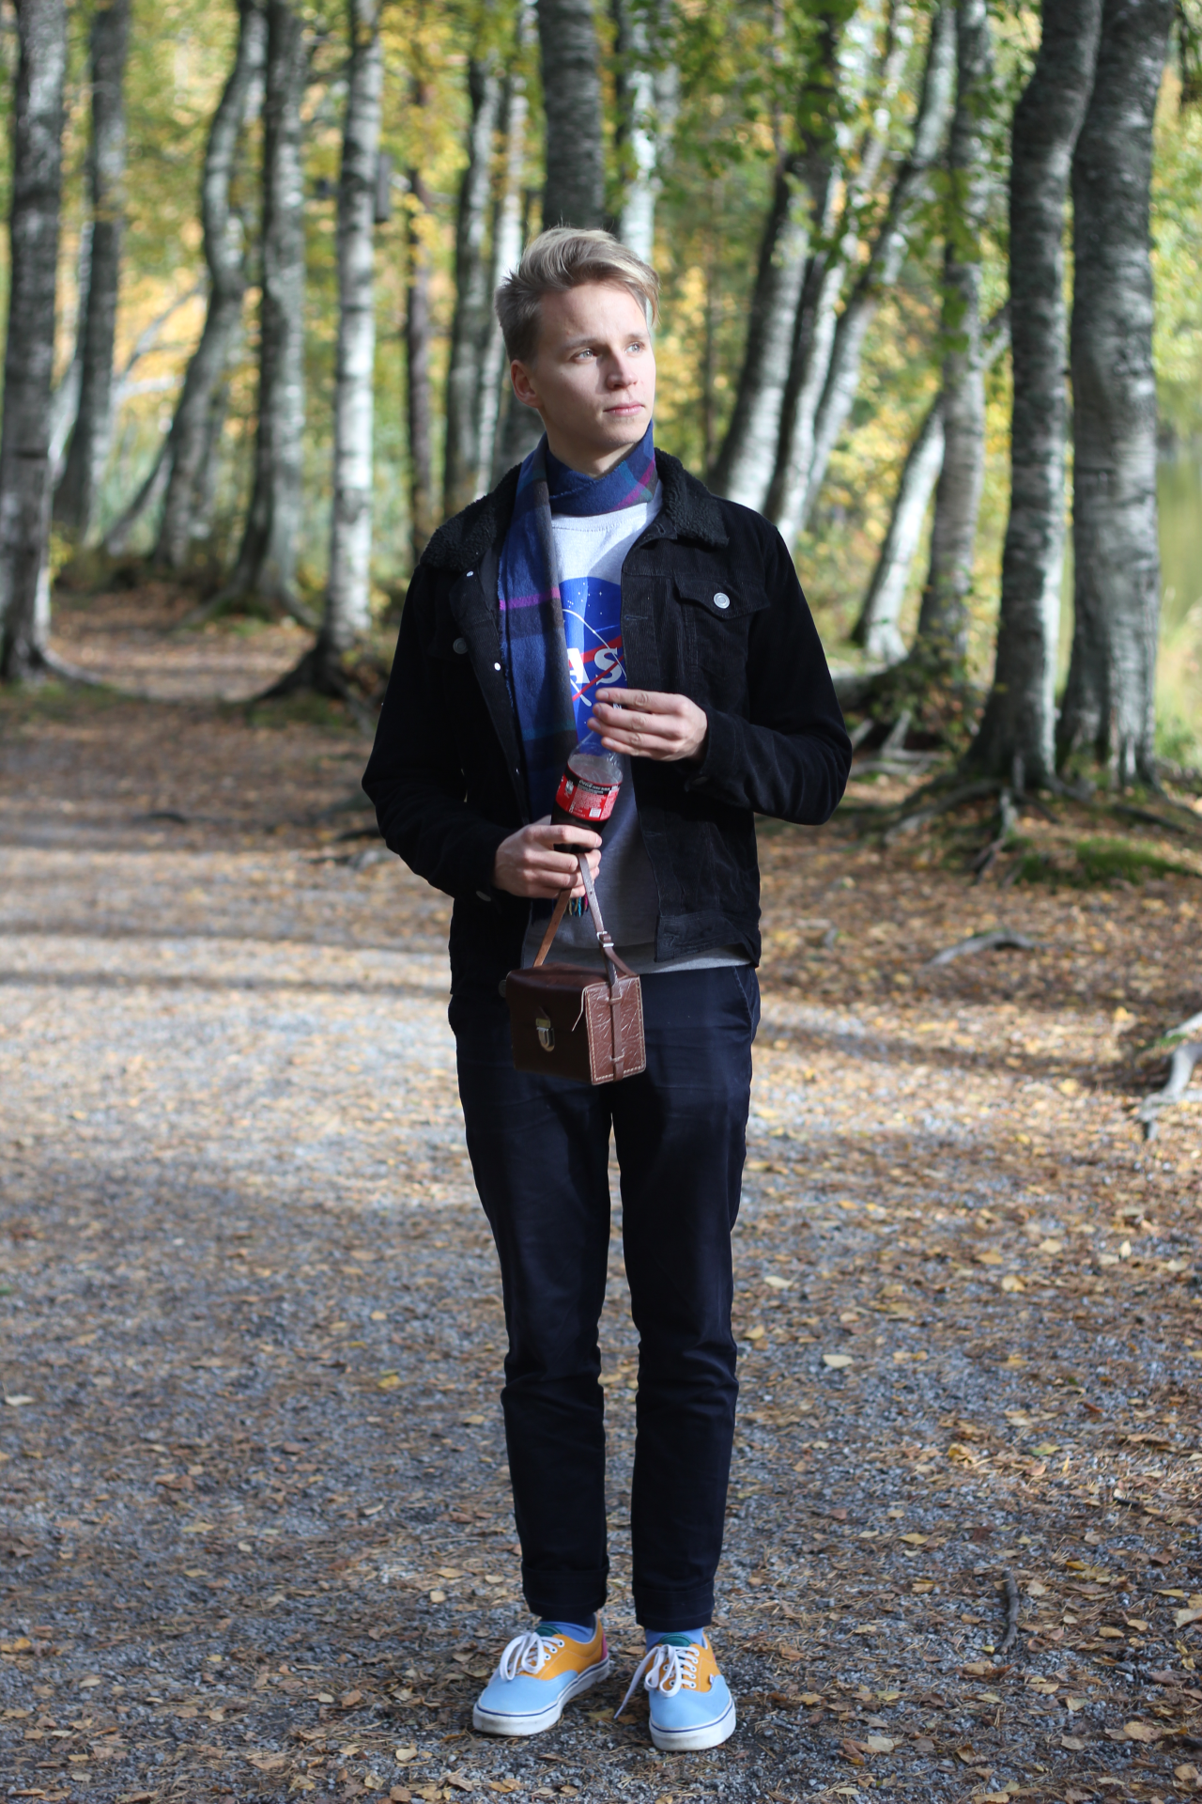



Comparison to SRGAN
Original
(PSNR)
Bilinear
(27.36)
SelfExSR
(29.95)
SRGAN
(29.70)

Slide 24
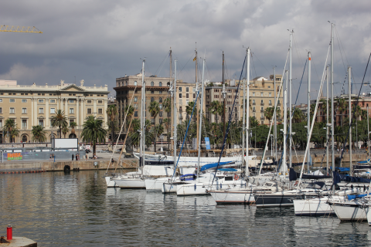
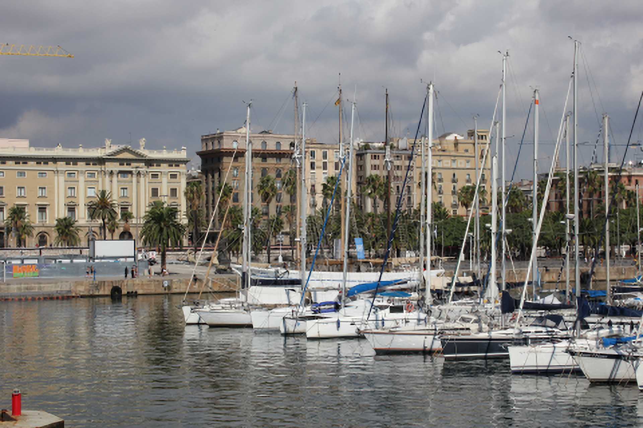


Comparison to SRGAN
Original
(PSNR)
Bilinear
(22.70)
SelfExSR
(23.58)
SRGAN
(22.10)

Slide 25




Comparison to SRGAN
Original
(PSNR)
Bilinear
(33.18)
SelfExSR
(34.65)
SRGAN
(27.91)

Slide 26
Conclusion
Performs well, considering there is no need for external data
Optimal at 4x scaling, lower has little effect and higher gives a “Picasso” effect
SRGAN has generally better IQ, but SelfExSR behaves better in noisy areas.
Pros:
No need for external data
Good results for a fairly simple algorithm
Cons:
Single image takes a long time to process
“Picasso effect” in noisy areas and bigger scales

